Slide 1

Enhancing Differential Evolution for Neural Network Optimization through Boundary Individual Consideration. Mandar Angchekar Evolutionary Machine Learning May 1, 2024

Slide 2

Drawback of DE
Boundary Exploration: DE can struggle with effectively exploring the boundaries of the search space, potentially missing out on optimal solutions that lie at the extremes.
Parameter Sensitivity: The performance of DE is highly sensitive to its control parameters, such as mutation factor and crossover rate. Incorrect settings can lead to poor convergence or excessive computation time.
Better for continuous optimization

Slide 3

Goal
Enhance the performance of Differential Evolution (DE) algorithms for neural network optimization.
Incorporate boundary individual consideration during the mutation process to improve search space exploration.
Target improved exploration of boundary regions, which may contain optimal or near-optimal solutions.
Achieve more robust and effective optimization results for neural networks.

Slide 4
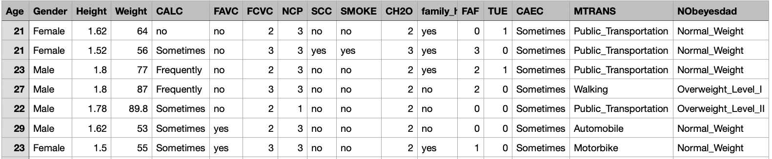
Dataset Description
The data was taken from kaggle
This dataset include data for the estimation of obesity levels in individuals from the countries of Mexico, Peru and Colombia, based on their eating habits and physical condition.
The data contains 17 attributes ( 8 continuous and 9 categorical ) and 2111 records.
8 are continuous such as Age, Height, Weight, FCVC (vegetable)
9 are Categorical such as Gender, Calc (calcium), FAVC (high calorie food), SMOKE
Added noise, relabel, more instances of Overweight_Level_I

Slide 5
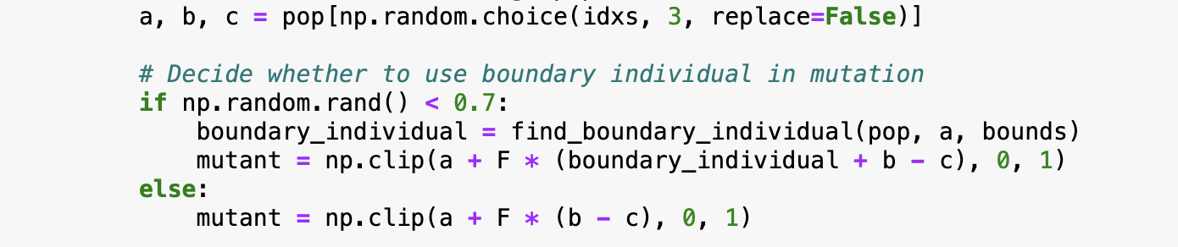
Algorithm
Find optimal number of layers and neurons.
Modified Mutation: Include boundary individual in the mutation. Mutation rate = 0.1 and Crossover rate = 0.7
Probabilistic Mutation: The new mutation happens probabilistically. This hyperparameter should be tuned after trail and testing. (0.2, 0.5, 0.7, 1.0)
Bounds: [5,5000] for neurons optimization.
Bounds: layers [1,5] and neurons [1,500]

Slide 6

Evaluation Criterion
Compared various probabilistic modified mutation DE algorithm with normal DE.
Fitness function: The function returns the accuracy of the model as the fitness value.

Slide 7
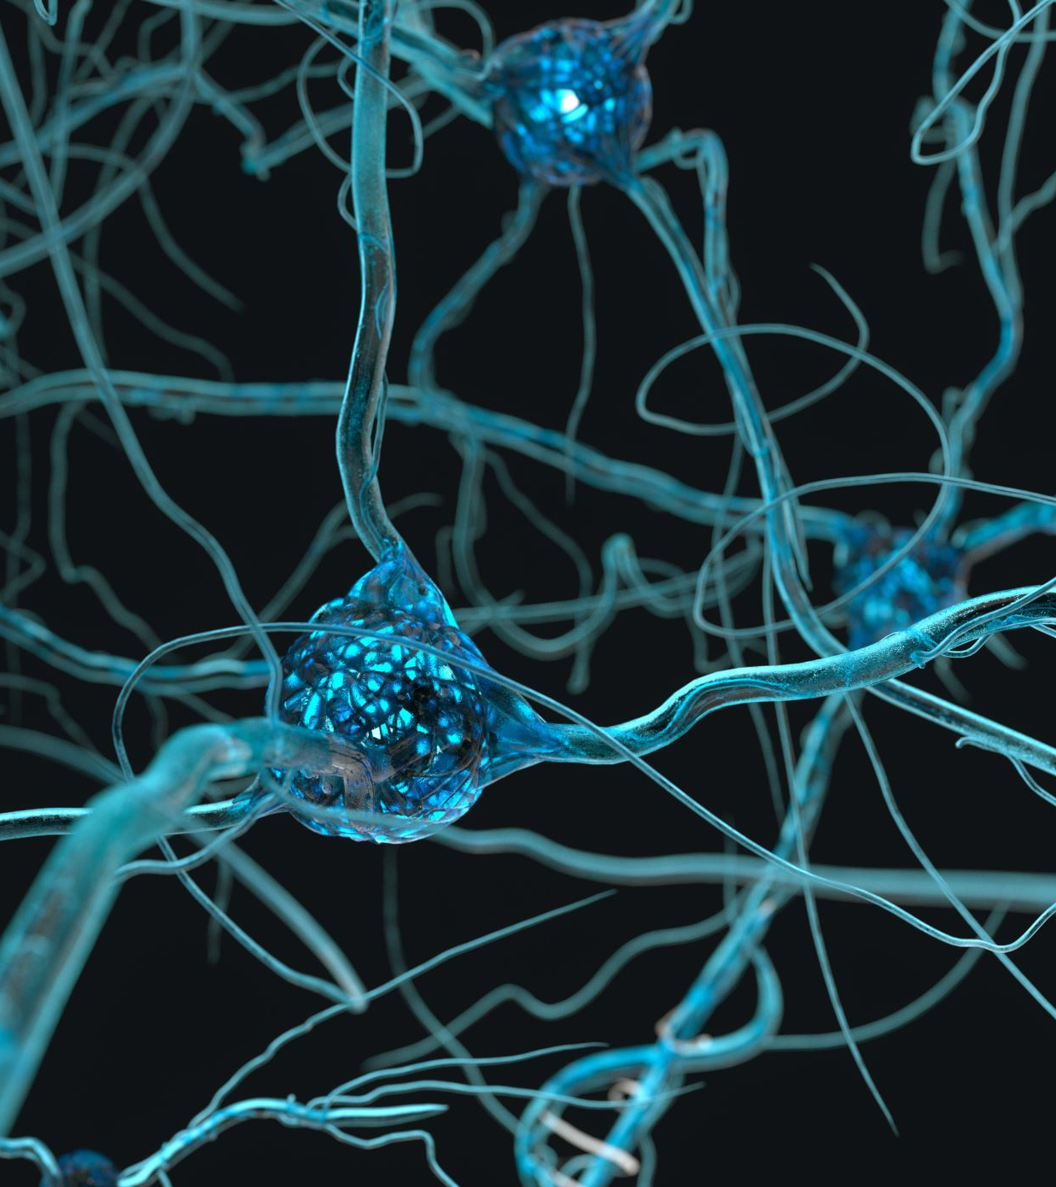
Results
Basic DE
DE with Neurons and Layer
DE with Boundary Consideration for Neurons Only
DE with Boundary Consideration for Neurons and Layers (Probability 0.2)
DE with Boundary Consideration for Neurons and Layers (Probability 0.5)
DE with Boundary Consideration for Neurons and Layers (Probability 0.7)
DE with Boundary Consideration for Neurons and Layers (Probability 1.0)

Slide 8
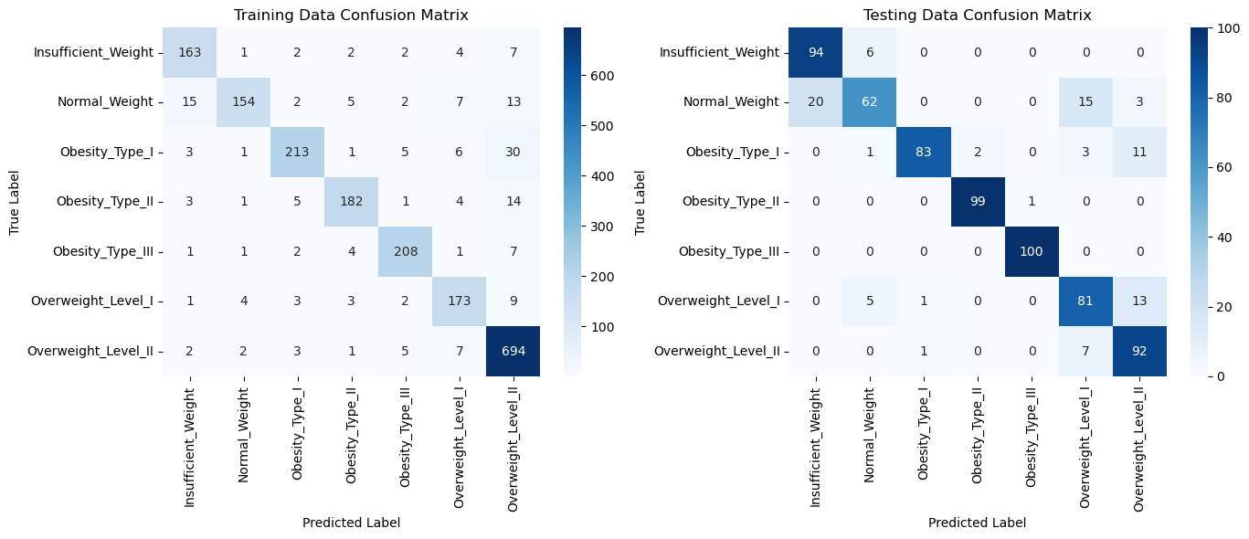
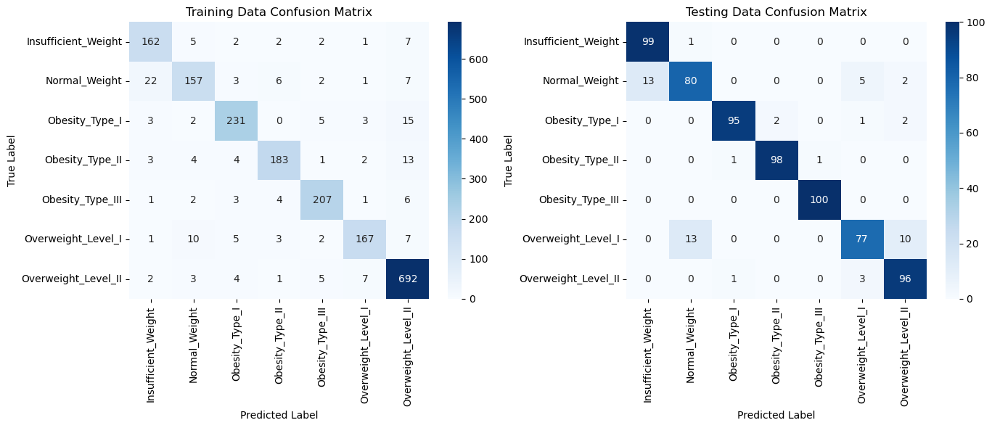
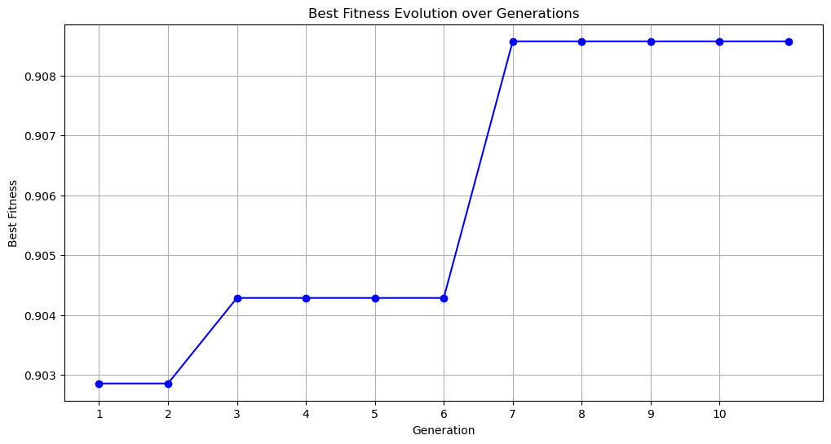
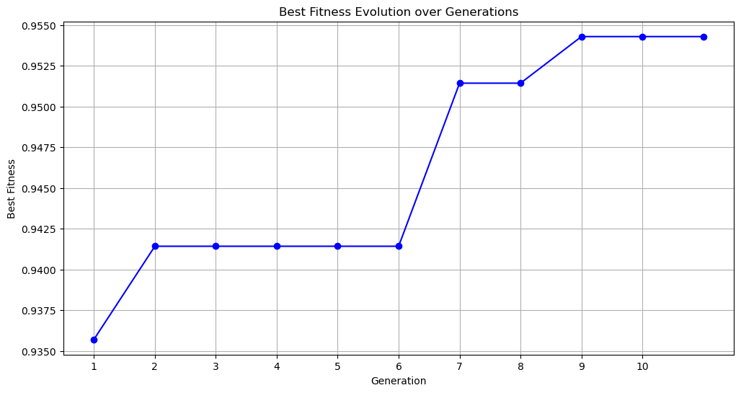
1. Basic DE
2. DE Neurons and Layers

Slide 9
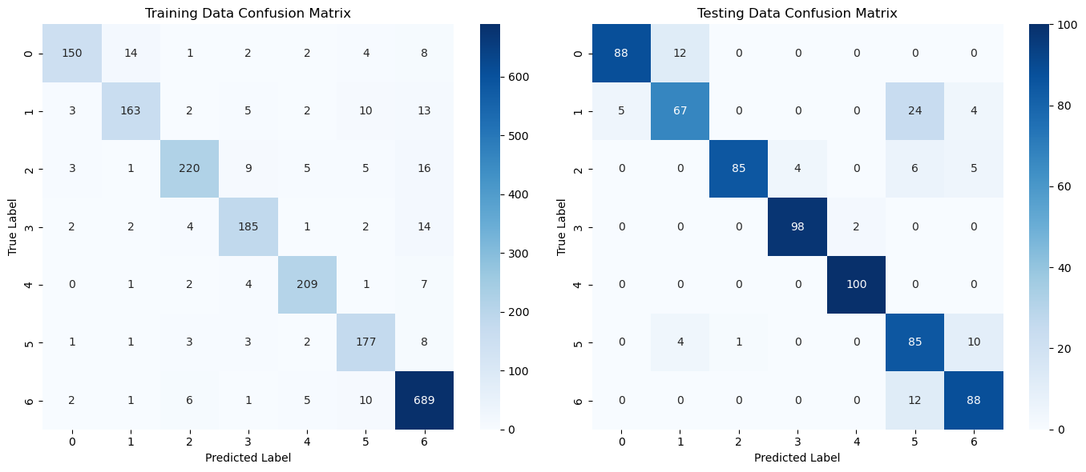
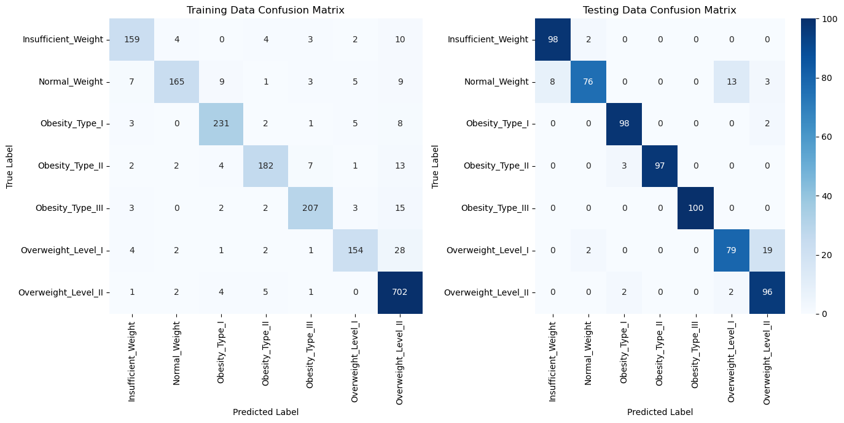
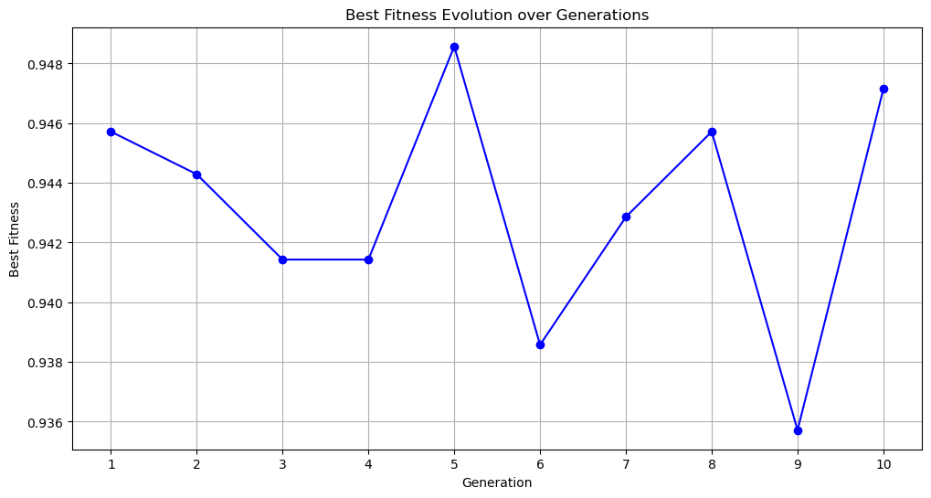
3. DE with Boundary Consideration for Neurons Only
4. DE with Boundary Consideration for Neurons and Layers (Probability 0.2)

Slide 10
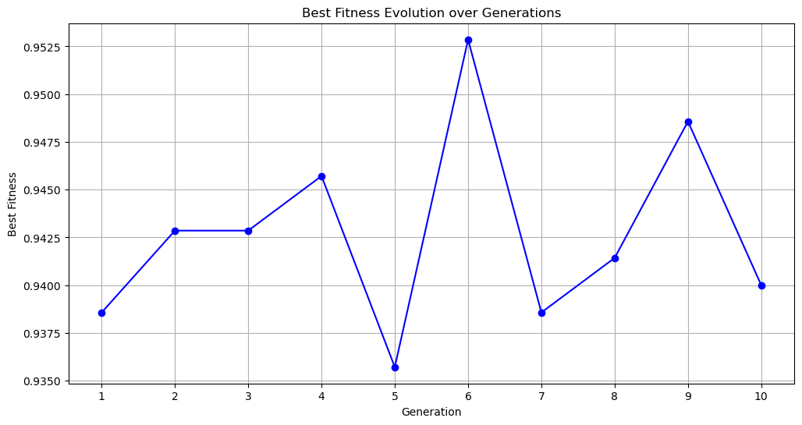
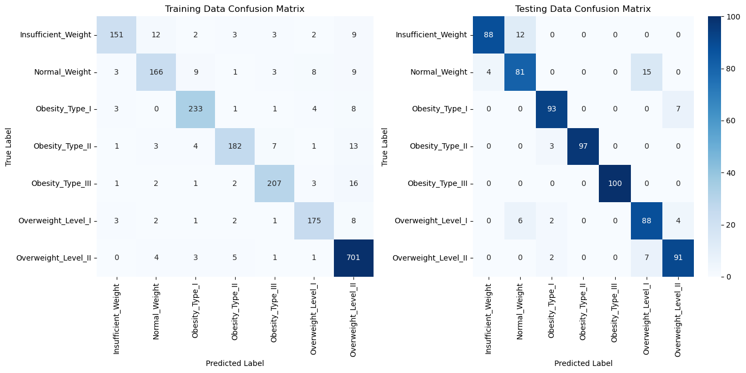
5. DE with Boundary Consideration for Neurons and Layers (Probability 0.5)

Slide 11
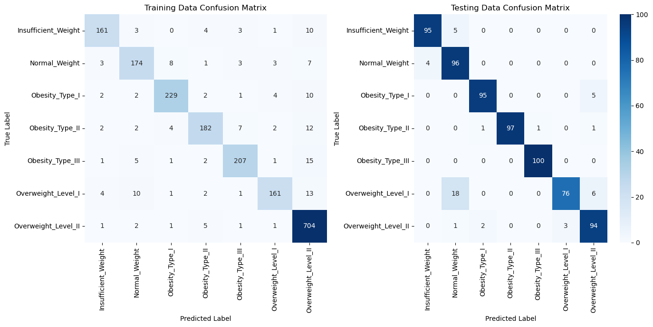
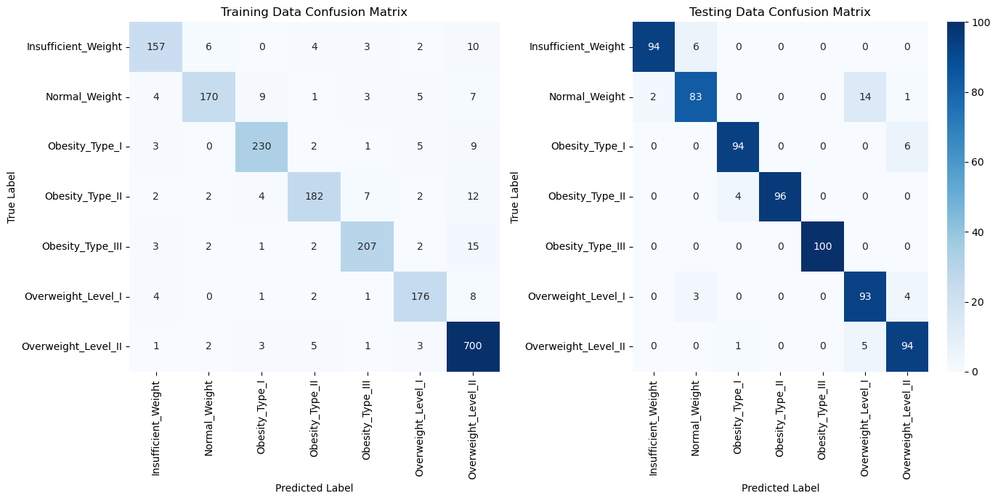
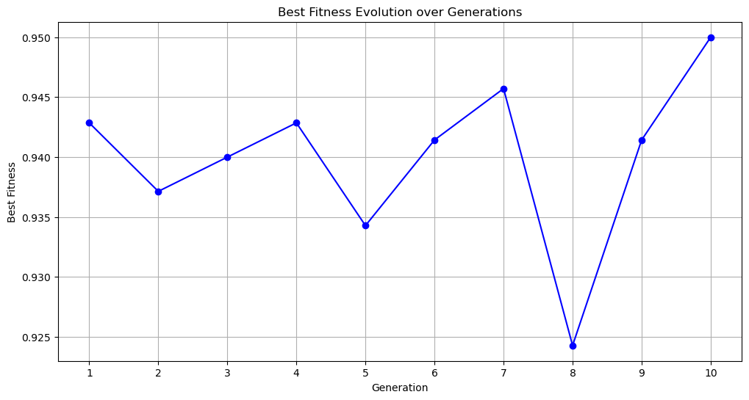
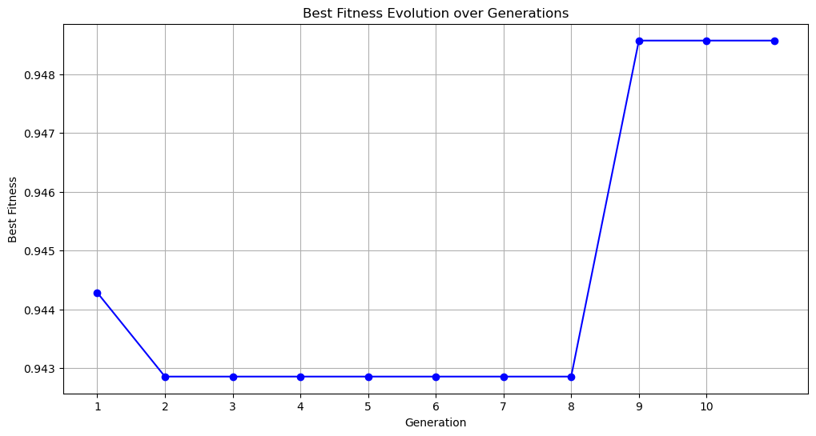
3. DE with Boundary Consideration
for Neurons and Layers (Probability 0.7)
4. DE with Boundary Consideration for
Neurons and Layers (Probability 1.0)

Slide 12
Computation Time
Basic DE: 614.69 seconds
DE with Neurons and Layer: 819.02 seconds
DE with Boundary Consideration for Neurons Only: 772.73 seconds
DE with Boundary Consideration for Neurons and Layers (Probability 0.2) : 862.74 seconds
DE with Boundary Consideration for Neurons and Layers (Probability 0.5) : 964.20 seconds
DE with Boundary Consideration for Neurons and Layers (Probability 0.7) : 926.29 seconds
DE with Boundary Consideration for Neurons and Layers (Probability 1.0) : 958.42 seconds

Slide 13

Conclusion
Boundary consideration improves DE's exploration capabilities, enhancing fitness and robustness of neural network architectures.
A probabilistic rate of 0.5 for boundary consideration optimally balances exploration and exploitation.
The approach is computationally efficient and stable across multiple runs, suitable for practical neural network optimization applications.
Adaptive mutation: F can be adapted based on feedback from the optimization process itself, such as the variance in fitness values.

Slide 14

References
Medium article: Neural Network Optimization (Part 1) — Differential Evolution Algorithm
F. Neri and V. Tirronen, "Recent advances in differential evolution: a survey and experimental analysis," Artificial Intelligence Review, vol. 33, pp. 61-106, 2010. DOI 10.1007/s10462-009-9137-2.
S. Das and P. N. Suganthan, "Differential Evolution: A Survey of the State-of-the-Art," IEEE Transactions on Evolutionary Computation, vol. 15, no. 1, pp. 4-31, February 2011.
R. Storn and K. Price, "Differential Evolution – A Simple and Efficient Heuristic for Global Optimization over Continuous Spaces," Journal of Global Optimization, vol. 11, pp. 341-359, 1997.
J. Liu and J. Lampinen, "A Fuzzy Adaptive Differential Evolution Algorithm," Soft Computing, vol. 9, pp. 448-462, 2005, DOI 10.1007/s00500-004-0363-x.

Slide 15
Thank you Questions/Suggestions?

